Slide 1
SPIKING NEURAL NETWORKS FOR FAST-MOVING OBJECT DETECTION
Mario Real Enrique

Slide 2
Problem Statement
Conventional cameras either introduce huge latencies or generate too much data
Problem for real-time ball trajectory prediction
We want to leverage event cameras and SNNs to extract the relevant information for the vision system of the goalkeeper (RoboCup).
2 pieces:
Data
Model

Slide 3
Data
Ball throws and rolls
Generate trajectories
Take snapshots in IsaacSim
Create video
Video to events simulator
Too heavy to run?
Alternative: Generate the videos with python (adding the shadow will be tricky)

Slide 4
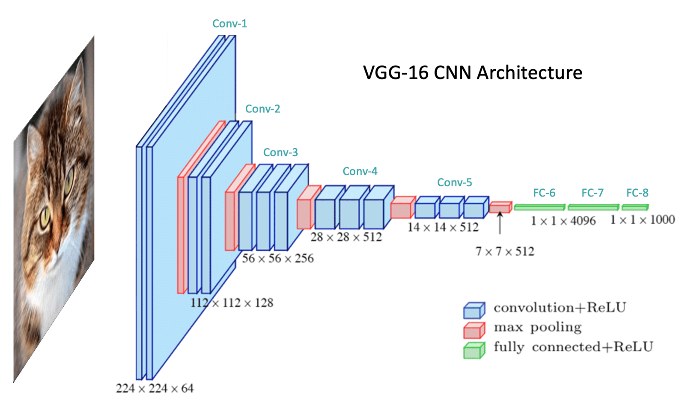
Architecture: Plan A
SCNN with surrogate gradient (supervised)
Output:
Variable:
Hitting point on the gate (x_goal, y_goal)
Position of the ball (x, y, size) -> ROI
Methods:
Classification
Regression

Slide 5

Architecture: Plan B
SCNN + LSM with surrogate gradient (supervised)
RSNN -> Better time encoding
Slower
Classification: Hitting point on the goal

Slide 6
What if everything fails?
Add a second camera
Retry plans A and B

Slide 7
What do I have for now?

Slide 8
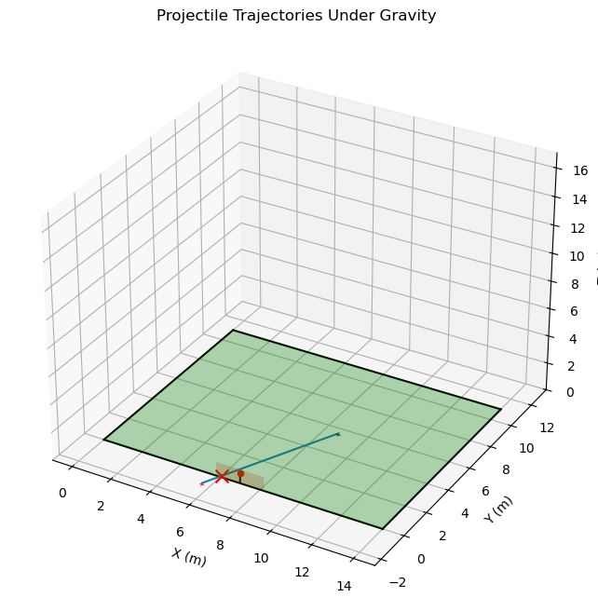
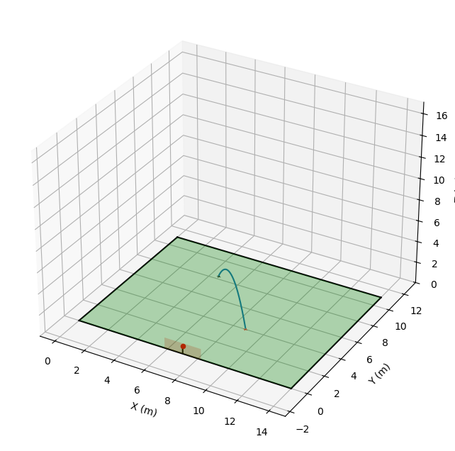
Trajectory generator

Slide 9


Trajectories -> Video -> Events

Slide 10

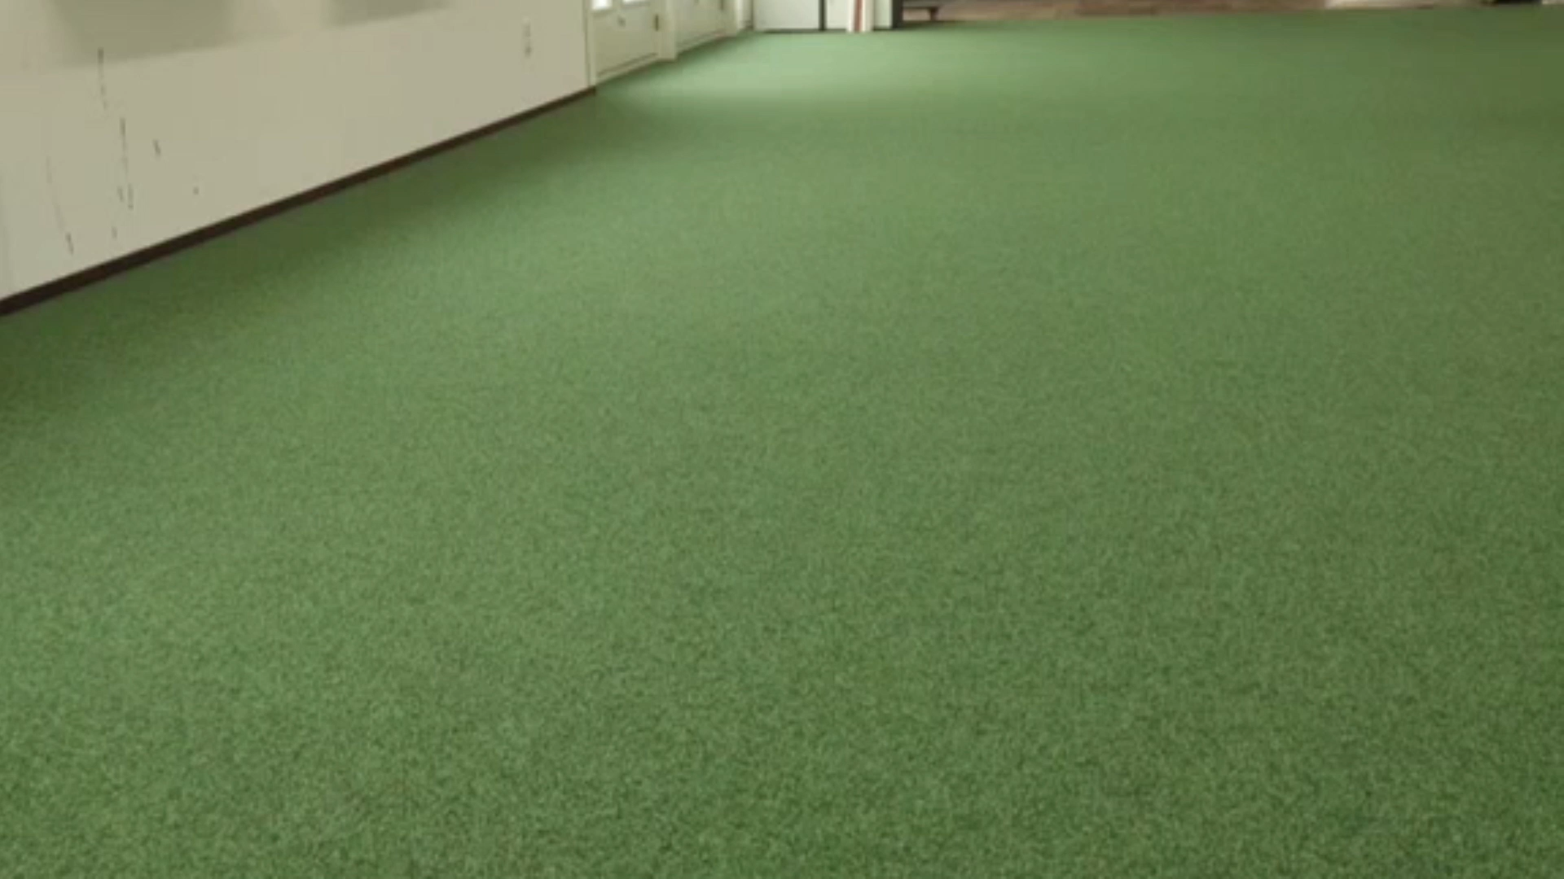
Real data

Slide 11

Ball tracker (labelling)

Slide 12
Next steps

Slide 13
Next steps
Developing an SCNN tracker using the labelled real-world data
Exploring additional video to events simulators that I can run locally
Estimating the computer cost of generating a dataset with IsaacSim

